Slide 1
HW4 - DCGAN
Jiaqian Yu

Slide 2
Deep Convolutional Generative Adversarial Network
Both Discriminator and Generator in the original GAN are multi-layer perceptrons.
A more popular choice is to use deep convolutional neural network to replace them.
This is so called the deep convolutional generative adversarial network(DCGAN).

Slide 3
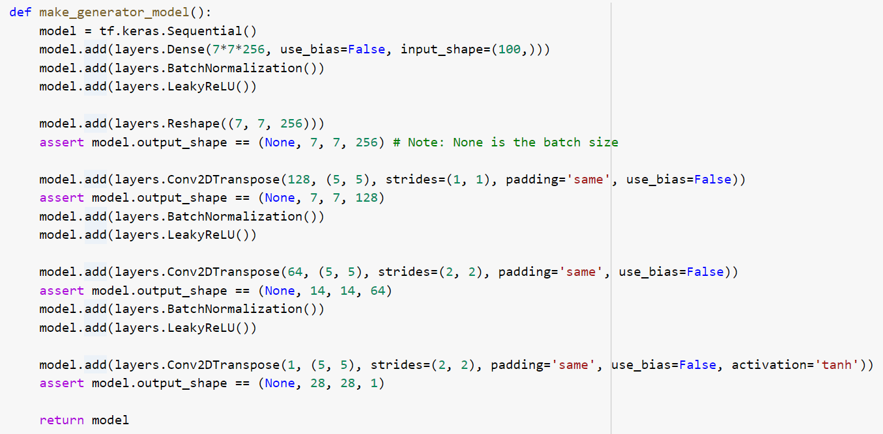
Initial Model - Generator
The generator uses tf.keras.layers.Conv2DTranspose (upsampling) layers to produce an image from a seed (random noise).
Start with a Dense layer that takes this seed as input, then use convolutional layers to upsample 3 times until reaching the desired image size of 28x28x1.
Use tf.keras.layers.LeakyReLU as activation function for each middle layers and use tanh for the output layer.

Slide 4
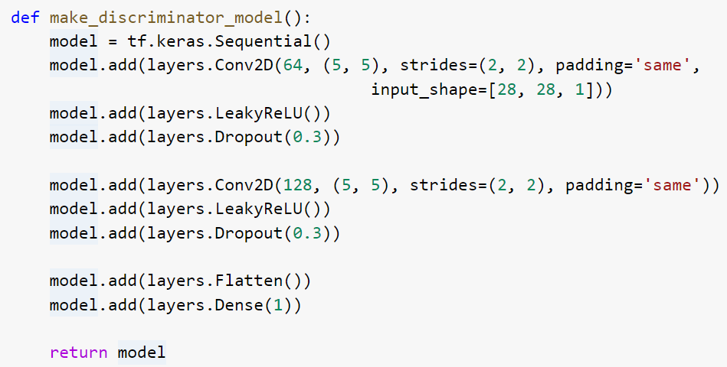
Initial Model - Discriminator
The discriminator is a CNN-based image classifier.
We use convolutional neural network: 2 convolutional layers with LeakyReLU as activation function and dropout rate 0.3.
The output layer is a flatten layer so the discriminator will be trained to output one value: positive for real images, and negative for fake images.

Slide 5
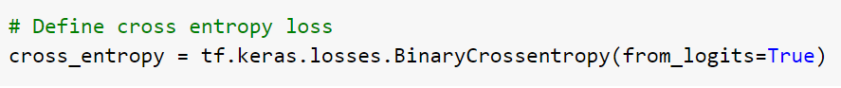
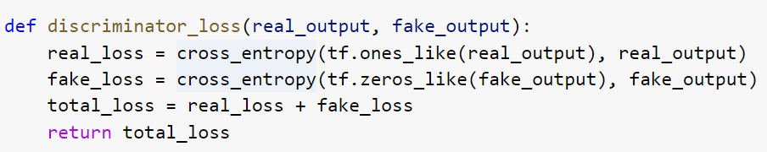
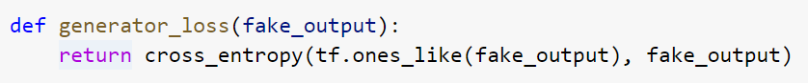
Initial Model - Loss
Discriminator Loss
Generator Loss
The discriminator's loss quantifies how well the discriminator is able to distinguish real images from fakes.
It uses cross entropy to compares the discriminator's predictions on real images to an array of 1s, and the discriminator's predictions on fake (generated) images to an array of 0s.
The generator's loss quantifies how well it was able to trick the discriminator. Intuitively, if the generator is performing well, the discriminator will classify the fake images as real (or 1).
Here, we will compare the discriminators decisions on the generated images to an array of 1s.

Slide 6
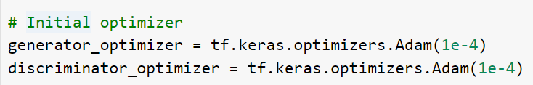
Initial Model - Optimizer
We use ADAM optimizer with parameter learning_rate= 1e-4

Slide 7
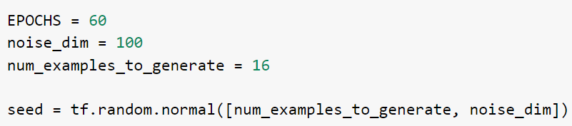
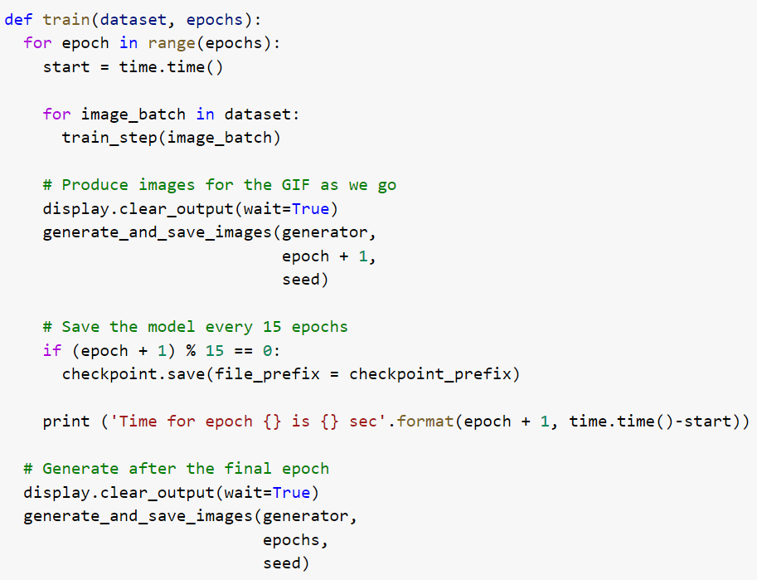
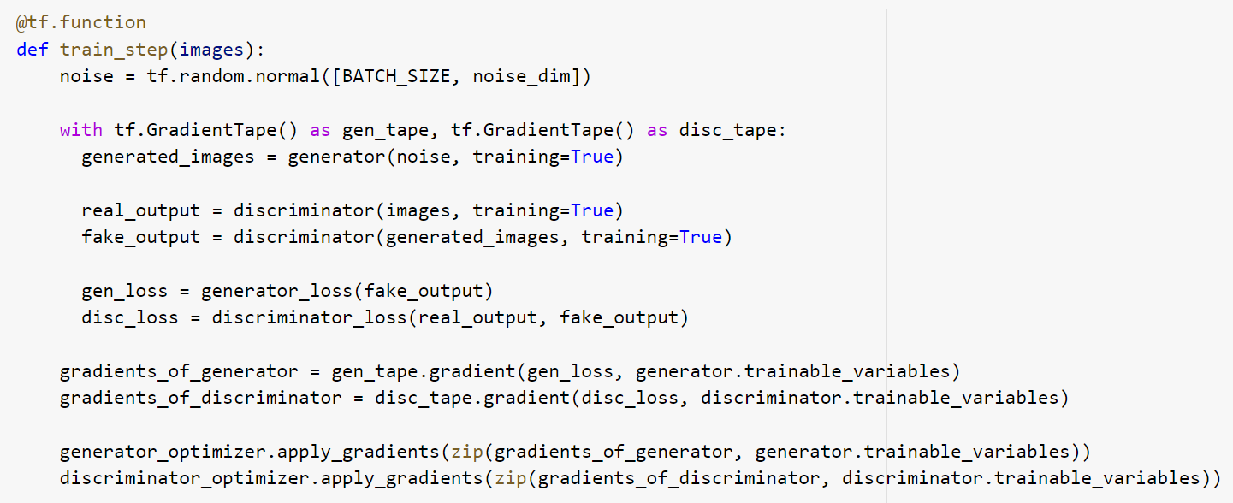
Initial Model - Training
Here we set # Epochs as 60 so the model will be trained until the 60th epochs.
Also, we generate 16 examples(figures) for each epoch.
The training loop begins with generator receiving a random seed as input. That seed is used to produce an image.
The discriminator is then used to classify real images (drawn from the training set) and fakes images (produced by the generator). The loss is calculated for each of these models, and the gradients are used to update the generator and discriminator.

Slide 8
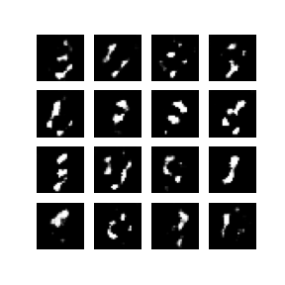
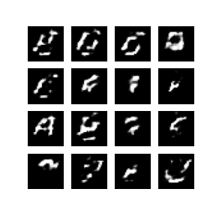
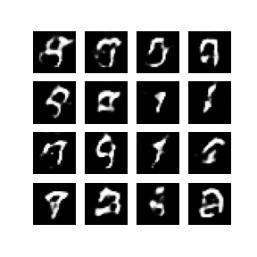
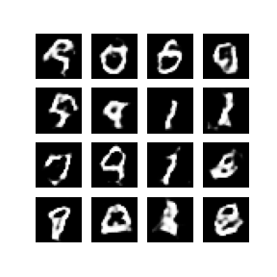
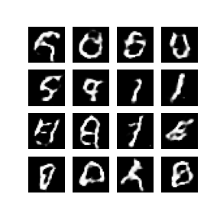
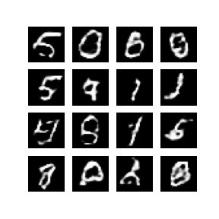
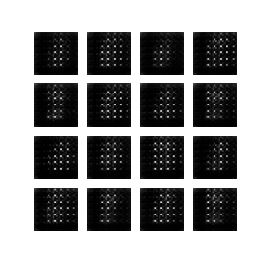
Initial Model - Result
We pick 16 seeds and show the generated images after 10th, 20th, 30th, 40th, 50th and 60th epochs.
We also show how the generators involve from the 1st epoch to the last epoch (60th) in a gif.

Slide 9
Initial Model – Problem
We can see the images become more like digit numbers (more like real dataset: MNIST) as we keep training the model.
Our results improve quickly during the first 30 epochs, however, as the iteration goes on, the improvement of the generated samples become smaller and even after 60 epochs, the generated images are not clear enough.
So I tried to improve the model by revising the discriminator (use another CNN) and also revising the optimizer with some tunned parameters.

Slide 10
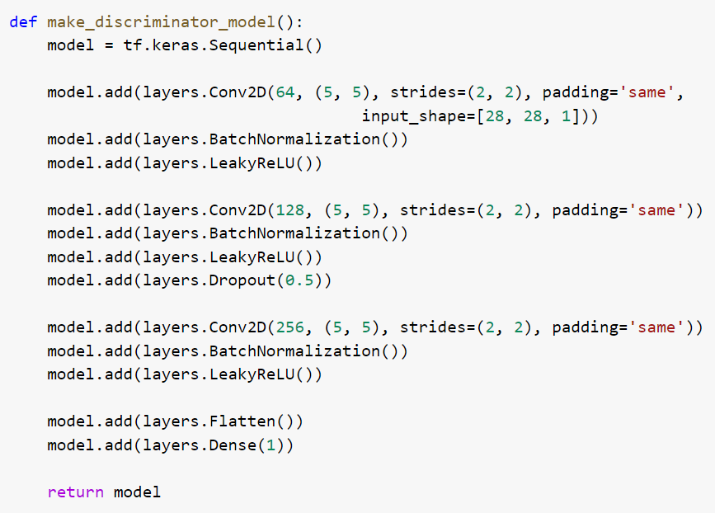
Improved Model - Discriminator
The discriminator is a CNN-based image classifier.
We use convolutional neural network: 3 convolutional layers with LeakyReLU as activation function and BatchNormalization. We only set one layer with dropout (rate = 0.5).
The output layer is a flatten layer so the discriminator will be trained to output one value: positive for real images, and negative for fake images.

Slide 11
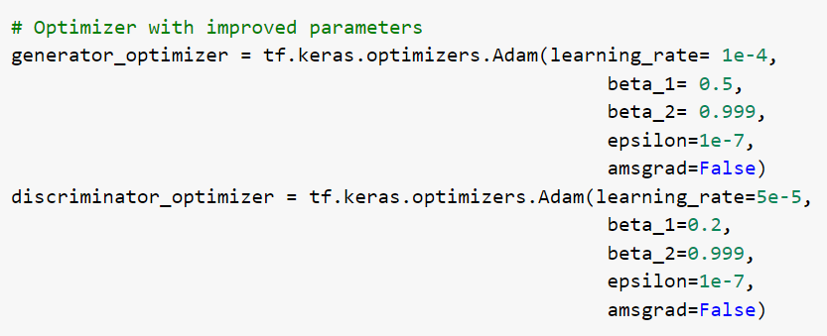
Improved Model - Optimizer
We use ADAM optimizer with tunned parameters learning_rate= 1e-4, beta_1 = 0.5, beta_2 = 0.999, epsion = 1e-7, amsgrad = False for generator and learning_rate= 5e-5, beta_1 = 0.2, beta_2 = 0.999, epsion = 1e-7, amsgrad = False for discriminator

Slide 12
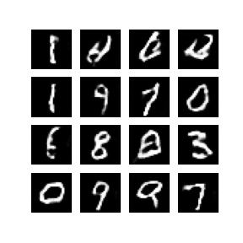
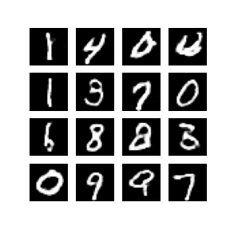
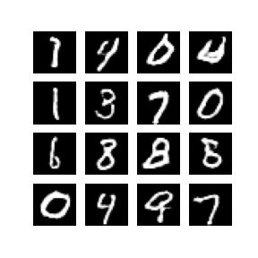
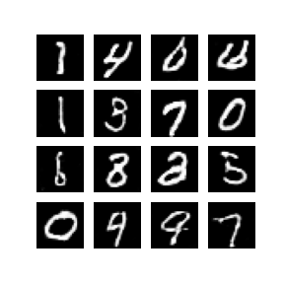
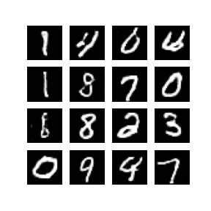
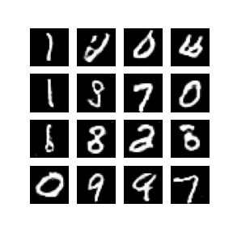
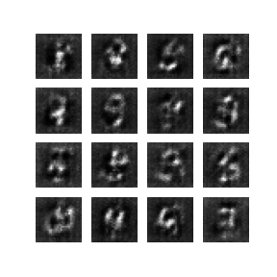
Improved Model - Result
We pick 16 seeds and show the generated images after 10th, 20th, 30th, 40th, 50th and 60th epochs.
We also show how the generators involve from the 1st epoch to the last epoch (60th) in a gif.

Slide 13
Improved Model – what I learnt
We can see the images generated by the new model improved much quicker than the initial one. Also after 60 epochs, images generated by the new model is more clear and more like digit numbers than the ones generated by our initial model. So the improvement is useful.
However, there still exists rotation in some of the images as iteration goes on and this is actually one of the main problems of GAN model.

